Slide 1
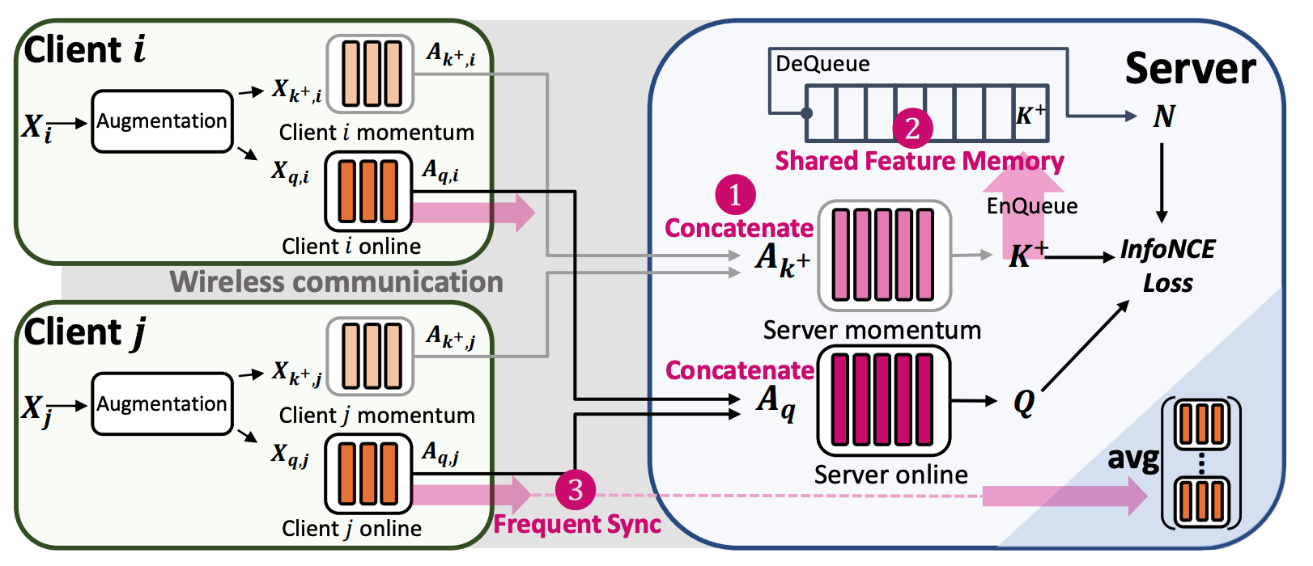
Challenge
The hyperparameters choises of TAResSFL seems not so easy: the authors admit that the choice of hyperparameters were largely based on intuition and trial-and-error in rebuttal.
The paper uses standard CV datasets (CIFAR-10/100/Imagenet). It would be interesting to see how the method performs on other application domains and noisy datasets.

